Slide 1

Flexicash
Designed and developed by:
Anthony Vrhovc, Dylan Kullas, and Ryan Zhou

Slide 2

The problem that makes Flexicash possible
People struggle to manage their money
Many Bank apps have too many unnecessary features
Not as transparent as some people would like
More people turn to programs like Flexicash to help them

Slide 3


What is Flexicash?
Financial management tool
Stores your information in a database
Allows for easy tracking of a user’s finances
Visual representations for spending statistics
Provides a safe platform for tracking your information
DB
Notes:
Allows users to easily track and manage finances

Slide 4

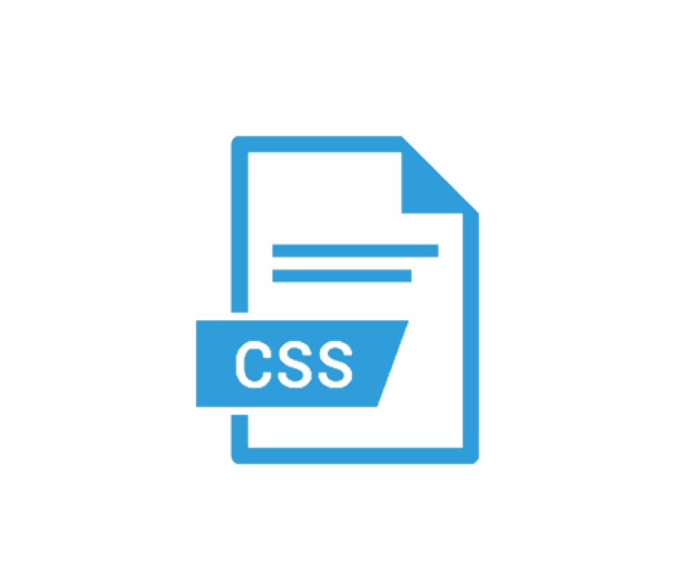

Areas Focused
Area 1: HTML, CSS, and graphics for page layout and design
Area 5: Put real data in a database, cookie, session storage, or local storage

Slide 5

How it works
User login information stored in a database
Login to access your account
Enter spending and income information to add it into the database
Displays visual representations of spending habits / stats
User uses this information to make a better financial plan

Slide 6

Problems we encountered
The database caused some problems in the beginning because we did not know how we wanted to store the users’ data
Github caused us many problems as well (when trying to share the files with each other)
Our time restriction also put pressure on us to make sure we had a working product (completely different schedules cause difficulty to get together)

Slide 7

Possible Future Developments
Link to bank accounts / cards & pull data from the banks
Flexibility route (similar to PayPal / Defter)
More useful for financing in user’s business(es)
Borrow & Repay system with financial calendar implemented
Simplicity route (similar to monday.com but with money only)
Acting like user’s financing advisor about his / her daily life

Slide 8
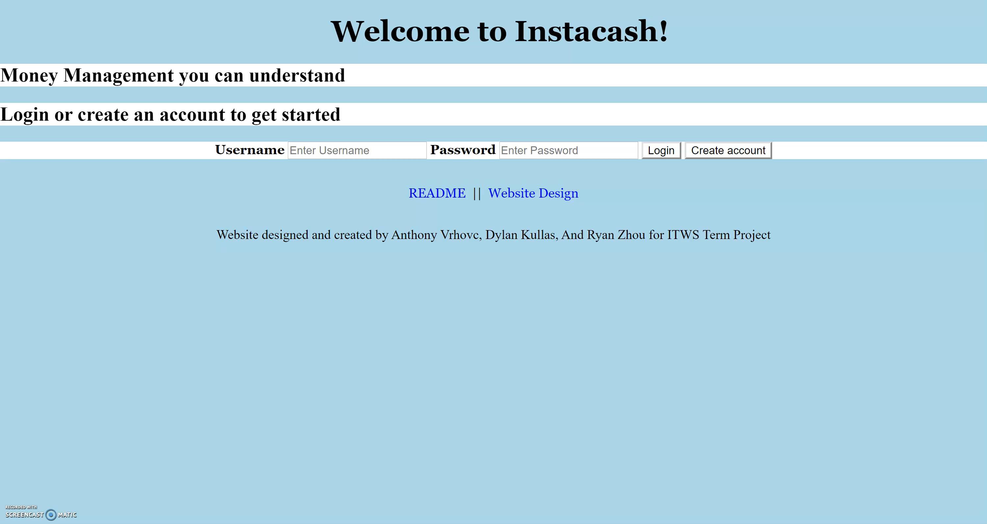
Demo
Link to site

Slide 9

Thank you
Questions?

